Slide 1
Connecting users with similar interests via tag network inference
Date: 2012/04/09
Source: Xufei Wang et. al (CIKM’11)
Speaker: Chiang,guang-ting
Advisor: Dr. Koh. Jia-ling

Slide 2
Outline
Introduction
Tag network construction
Diffusion on tag network
Recommend like-minded users
Experiment
Conclusions

Slide 3
Introduction
Social networking is increasingly becoming an integral part of social life in which friend recommendation is an important feature.
We could accelerate information sharing and problem solving.

Slide 4
Introduction
The challenges of connecting like-minded users are summarized below:
People only have an egocentric view of the social network.
The scale of a social network website like Facebook, Twitter, or LinkedIn makes manual search unrealistic.
Friend recommendation based on connectivity between users have limitations due to the long tail distribution.
Notes:
1. i.e., users only see their immediate contacts.
2. Thus, more eﬀective and eﬃcient tools are necessary.
3. as shown earlier, recommendation based on links have
limitations due to the long tail distribution.

Slide 5
Introduction
Why friend recommendation merely based on connectivity
Ineﬃcient
The space complexity of an exhaustive search is exponential.
Incomplete
Reaching the long tail users who accounts for 80% of the populatioin in a social network is not trivial.
Notes:
2. and in certain scenarios, some long tail users are not reachable at all. Thus search methods based on links could fail.

Slide 6
Introduction
1.
DB
Tag Network
Diffusion
kernel
Top-k
2.

Slide 7
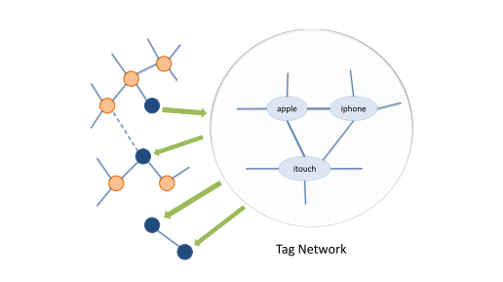
Introduction
Propose to connect like-minded users via tag network inference.
users

Slide 8
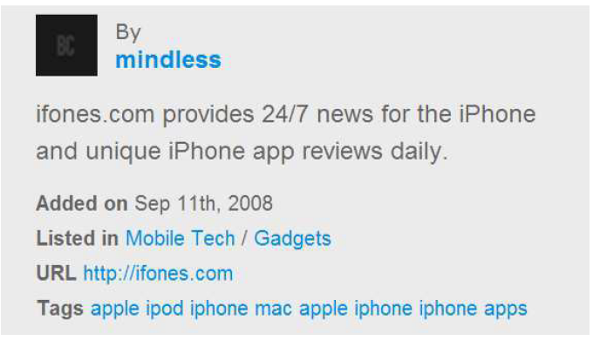
Tag network construction
User name
categories
BlogCatalog is a blogger only social network and blog directory. The site’s purpose is to help bloggers connect, share ideas, and grow through group and general discussions. It also provides a variety of tools, features, and widgets to help bloggers.
Relevant tags
Notes:
BlogCatalog is a blogger only social network and blog directory. The site’s purpose is to help bloggers connect, share ideas, and grow through group and general discussions. It also provides a variety of tools, features, and widgets to help bloggers.

Slide 9
Tag network construction
The steps to construct a tag network on the BlogCatalog dataset
For each object (e.g. blog) and its descriptive tags, we connect the tags as a clique
For each person, we combine all cliques corresponding to the objects he owns and form one or more un-weighted tag networks, since the tags may or may not be connected in a tag network
Construct a weighted tag network by aggregating all tag networks belonging to each person. In the weighted tag network, tags correspond to the union of all users’ vocabularies, and the weight of each link represents the number of users who use both tags simultaneously
Notes:
We count the number of users instead of the number of times two tags are used simultaneously as the weight of each link to avoid bias from spam users,
i.e., those who may use automated tools to assign the same group of tags many times.

Slide 10
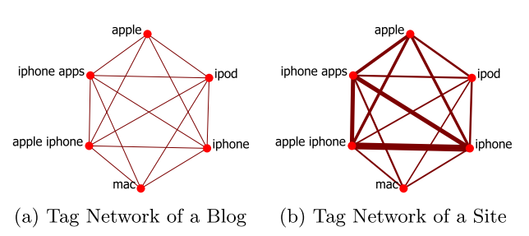
Tag network construction
Step 1
Step 3
Notes:
We count the number of users instead of the number of times two tags are used simultaneously as the weight of each link to avoid bias from spam users,
i.e., those who may use automated tools to assign the same group of tags many times.

Slide 11
Diffusion on tag network
The tag network enables us to measure the similarities between any pair of tags within it
The simplest measure of similarity between two tags is the shortest path distance.
The shortest path distance is susceptible to change in graph structure
Therefore, we prefer to average all path distances between two given tags for a more robust similarity measure shortest path distance is easy to change in graph structure.
similarity measure: diffusion kernel

Slide 12
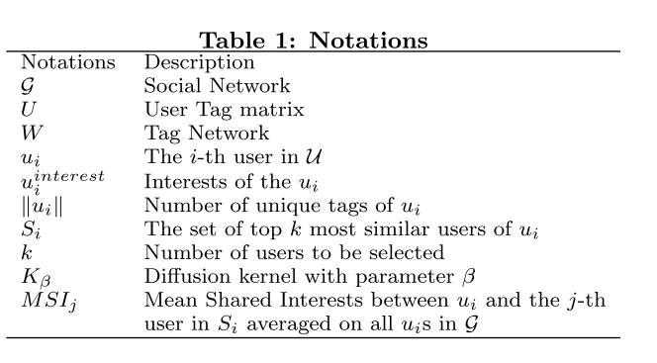
Diffusion on tag network
u2
u1
u3
u6
u4
u5
U | t1 | t2 | t3 | t4
u1 | 1 | 4 | 1 | 0
u2 | 0 | 0 | 5 | 5
u3 | 2 | 9 | 0 | 1
u4 | 3 | 6 | 0 | 0
W | t1 | t2 | t3 | t4
t1 | 14 | 2 | 5 | 7
t2 | 2 | 5 | 1 | 2
t3 | 5 | 1 | 12 | 6
t4 | 7 | 2 | 6 | 15

Slide 13
Diffusion on tag network
Laplacian matrices
$L=W−D$
D is a diagonal matrix in which the i-th diagonal entry corresponds to the summation of the entries in i-th column of matrix W.
W | t1 | t2 | t3 | t4
t1 | 14 | 2 | 5 | 7
t2 | 2 | 5 | 1 | 2
t3 | 5 | 1 | 12 | 6
t4 | 7 | 2 | 6 | 15
D | t1 | t2 | t3 | t4
t1 | 14 | 0 | 0 | 0
t2 | 0 | 5 | 0 | 0
t3 | 0 | 0 | 12 | 0
t4 | 0 | 0 | 0 | 15
L | t1 | t2 | t3 | t4
t1 | 0 | 2 | 5 | 7
t2 | 2 | 0 | 1 | 2
t3 | 5 | 1 | 0 | 6
t4 | 7 | 2 | 6 | 0

Slide 14
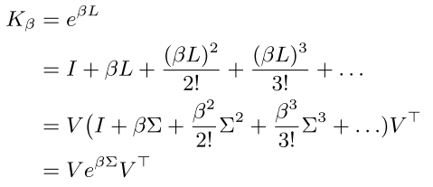
Diffusion on tag network
The diﬀusion kernel $K_{β}$ of a tag network
β ≥ 0 is a user speciﬁed parameter which controls the speed of diﬀusion
$L=V\sum{V^{Τ}}$, the columns of V are the eigenvectors, Σ is a diagonal matrix whose diagonal entries are eigenvalues

Slide 15
Recommend like-minded users
Goal :
select the top k most relevant users in terms of similarity from the social network.
Similarity between two users
$u_{i}$ : seed user, $K_{β}$:the kernel
$u_{i}(t)$ :the number of times the tag t is used by user i
$\left\|u_{i}\right\|$, $\left\|u_{j}\right\|$ : Number of unique tags of user
Notes:
The normalization is necessary because it prevents selecting spammers who use a large number of tags. But users who share more semantically relevant tags are credited thus we use the square root for both normalization terms.

Slide 16
Experiment
Dataset
BlogCatalog is an online blog service which enables bloggers to register, manage, share, and connect blogs.
Measure | BlogCatalog
Nodes | 88,784
Edges | 1,409,112
Category | 60
Unique Tags | 5,713
Average Tags | 4.0
Tags that are used < 10 users are removed

Slide 17
Experiment
Baseline Methods
Triadic Closure
This approach returns the top k people who are two hops away (friends of friends) in a social network. Note that it may return potential friends, but not necessarily return the most similar users.
Latent Semantic Indexing
It is used to capture semantic correlation by applying Singular Value Decomposition (SVD).
This approach computes the cosine similarity between an arbitrary pair of users in the latent space and can connect like-minded users who are far apart in a social network.
b
a
c

Slide 18
Experiment
Evaluation Metrics
The quality is evaluated by the number of shared interests between the seed user and the selected users.
Mean Shared Interests(MSI):
$u_{i}$: seed user, ${u_{i}}^{interest}$:set of interest(category)

Slide 19
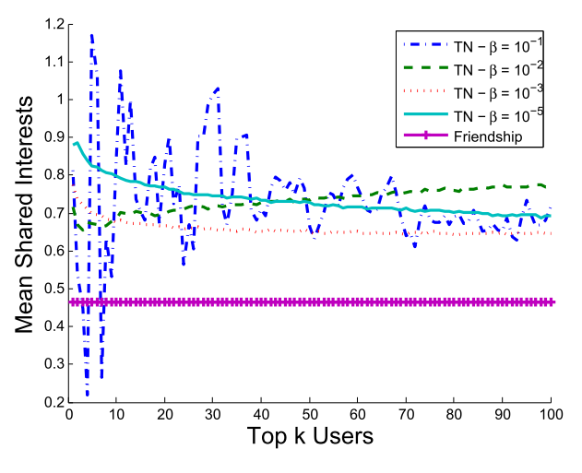
Experiment -different β values
user with immediate friends

Slide 20
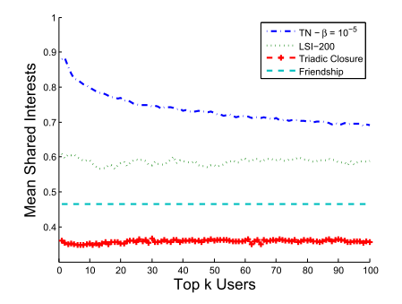
Experiment -different method

Slide 21
Experiment -hop distance from the seed users
As shown in this figure, statistically, the majority of the most similar users are 2, 3, and 4 hops away. A small number of users who are 5 or 6 hops away from the seed users

Slide 22
Conclusions
Propose to connect like-minded users via tag network inference.
Demonstrate that the tag network approach outperforms the two baseline methods based on triadic closure and latent semantic indexing.
Experimental results also show the proposed approach is capable of recommending users with similar interests who are far apart when using links as the distance metric.

